Slide 1
Selenium Automation Project
E-commerce Website: Cărturești Bookstore

Slide 2
Test approach and scope
My objective was to test basic functionalities with a focus on how different users might interact with the store.
I did not test the features in depth, but took a more exploratory approach.
As a result, some tests will cover more than one feature.
I tried to make tests that can be easily modified and updated if certain features need to be tested more in depth in the future.
I chose the Carturesti website because it is complex enough to provide a challenge and has features that are common for most e-commerce websites.

Slide 3

Project Structure
In this project I used Page Object Model (POM), and created separate Page Object classes that contain methods to interact with those pages.
POM makes tests easier to maintain and modify, especially if methods are used in several tests.
Having methods stored in a page class also increases readability, as the tests become less clustered.
In this project, I have three Page Object classes, a Main Page, and Checkout and Wishlist pages, which extend the main page.

Slide 4
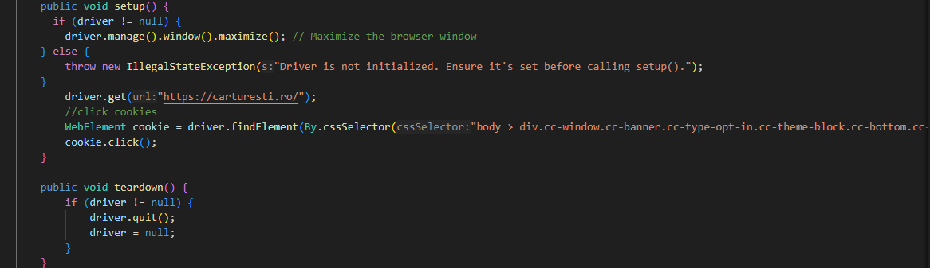
Tests - Base Test
Contains elements that are used for all other tests: sets up the browser, goes to the main page, clicks the cookies and closes the browser after the tests are completed.
All other tests extend the Base test. This avoids repeating the same code in multiple places.

Slide 5
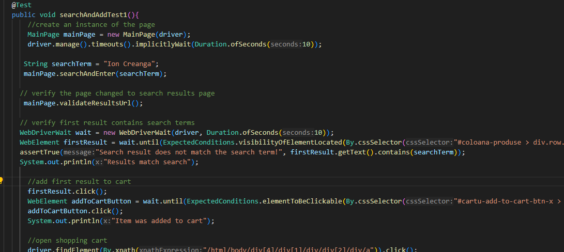
Tests - Search and Add
Searches for a product using the search bar, adds the first result to cart and proceeds to the checkout page.
Several asserts are placed along the way to verify everything works as expected.

Slide 6
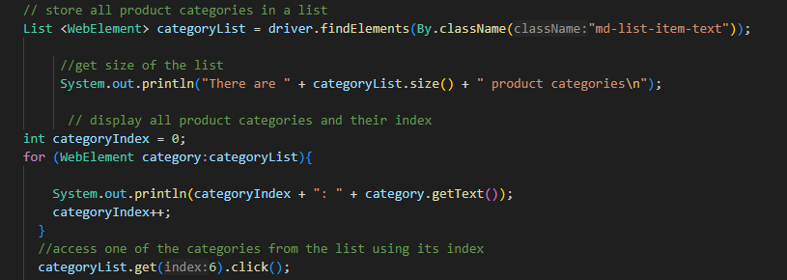
Tests - Browse and Add
Selects an item to add to cart through browsing and using filters.
Utilizes lists to access categories and subcategories using index.
Applies filters and changes sorting order.

Slide 7
Tests - Checkout
Tests the checkout flow and some of its functionalities.
Uses method used in the search test to quickly add items to cart.
Attempts to enter a voucher code, checks error message.
Checks the delivery fee message and changes the number of items in the cart.
Logs the user in from the checkout page
Fills the delivery form with name, address and contact details

Slide 8
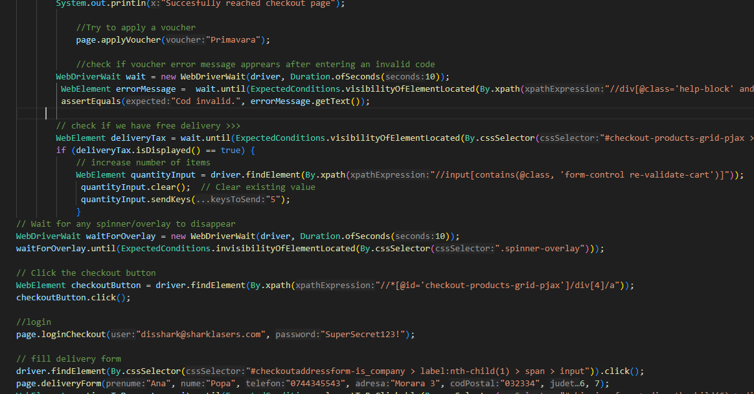

Slide 9
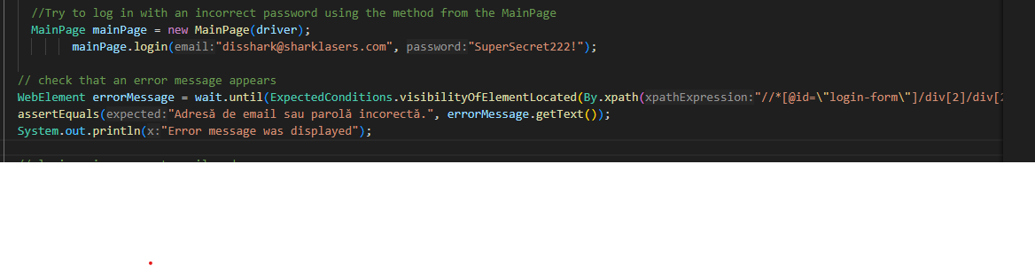
Tests - Login
Checks the Login flow from the main page
Email and password were created in advance for this test
Tries to enter a wrong password and checks for an error message
Enters the correct credentials into the new form

Slide 10
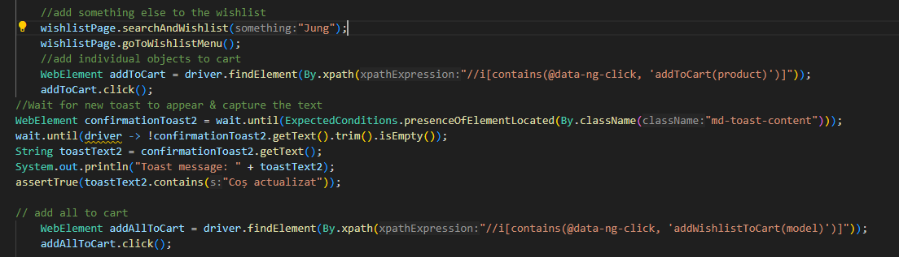
Tests - Wishlist
Tests wishlist functionality for users who are logged in:
Create a new wishlist, add items to the wishlist, add items from wishlist to cart, delete the wishlist, checks toast messages.

Slide 11
Thank You!

